Slide 1

Ruby on Rails
By Scissor
2016.05.30

Slide 2
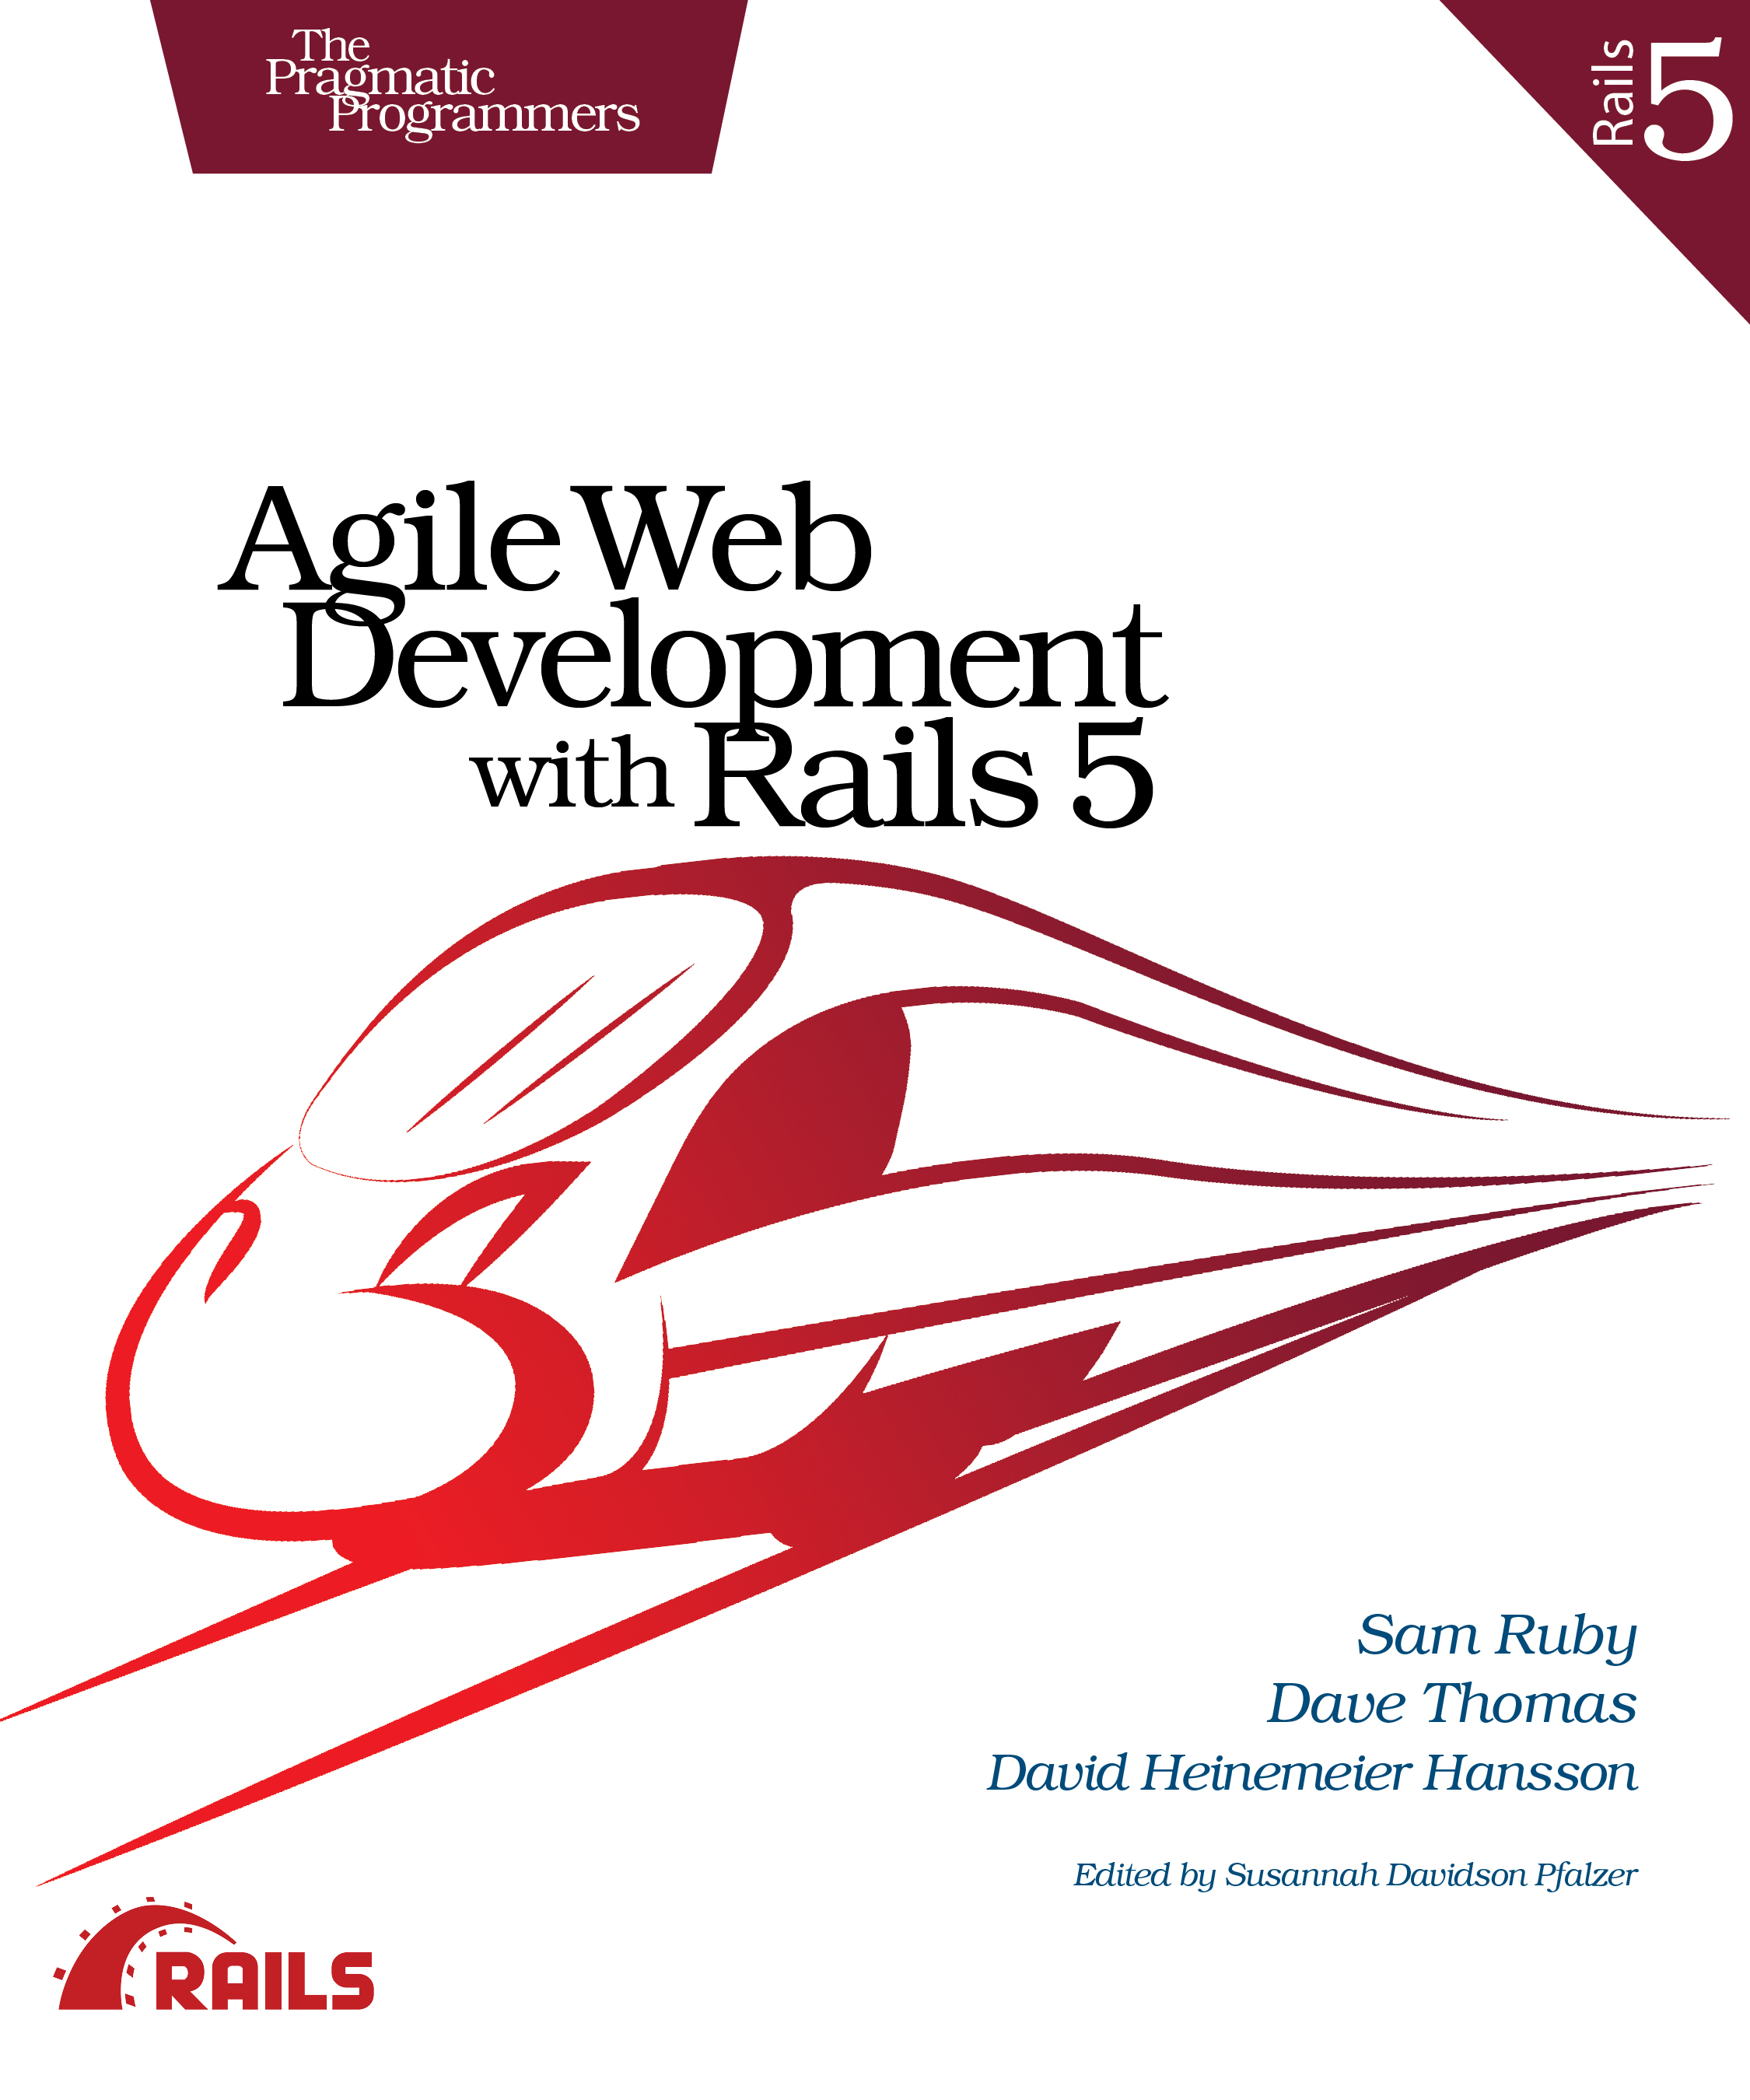

Reference
Agile Web Development with Rails
Ruby on Rails 實戰聖經

Slide 3
Outline
Environment & Tools
Principle
Install Ruby & Rails
Create new rails project
Scaffold
ORM & Migrations
Route

Slide 4
Environment & Tools

Slide 5
My Environment & Tools
Editor: Sublime
  Packages: Package Control, Git, Gitgutter, Emmet
Terminal: iTerm2
Database:
  SQLite: SQLite Browser
  MySQL: Sequel Pro

Slide 6
Tools
Editor
Terminal
Iaas
Paas

Slide 7
Editor
TextMate
Sublime
Vim
Atom

Slide 8
Iaas
Amazon Elastic Compute Cloud
Linode
DigitalOcean
Google Compute Engine

Slide 9
Paas
Heroku
Rails Machine
Brightbox
Engine Yard

Slide 10
Principle

Slide 11
Principle
DRY (Don’t repeat yourself)
COC (Convention Over Configuration)

Slide 12
Install Ruby & Rails

Slide 13
Install Ruby & Rails
1. 安裝 Homebrew
  ruby -e “$(curl -fsSL https://raw.githubusercontent.com/Homebrew/install/master/install)"
2. 安裝 Ruby
  brew install ruby
3. 下載並安裝 RubyGems
  ruby setup.rb
4. 安裝 Rails
  gem install rails –no-ri –no-rdoc

Slide 14
Create New Rails Project

Slide 15
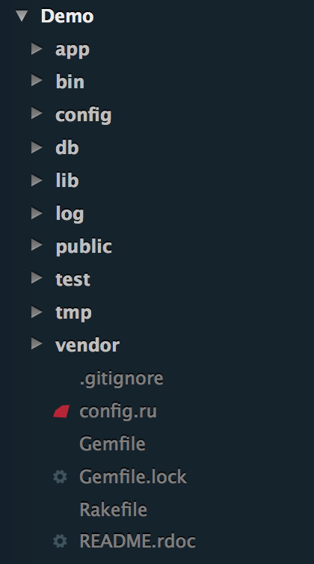
Create New Rails Project
rails new Demo -d mysql
rails s -p 1234

Slide 16
Scaffold

Slide 17
Scaffold (1)
rails generate scaffold Book

Slide 18
Scaffold (2)
rails generate scaffold Book
category:string title:string image:string

Slide 19
ORM & Migrations

Slide 20
Route

Slide 21
Route
resources :books
  get 'posts' => 'posts#index'
  get 'posts/new' => 'posts#new'
  post 'posts' => 'posts#create'
  get 'posts/:id' => 'posts#show'
  get 'posts/edit' => 'posts/edit'
  put 'posts/:id' => 'posts#update'
  delete 'posts/:id' => 'posts#delete'

